Slide 1

Anesthesia for
Microvascular Flap Surgery
Collective review
4 Dec 2019
R3 Suparerk

Slide 2
Outline
Introduction
Physiological considerations
Pre-operative assessment
Intraoperative anesthetic management
Postoperative anesthetic management

Slide 3
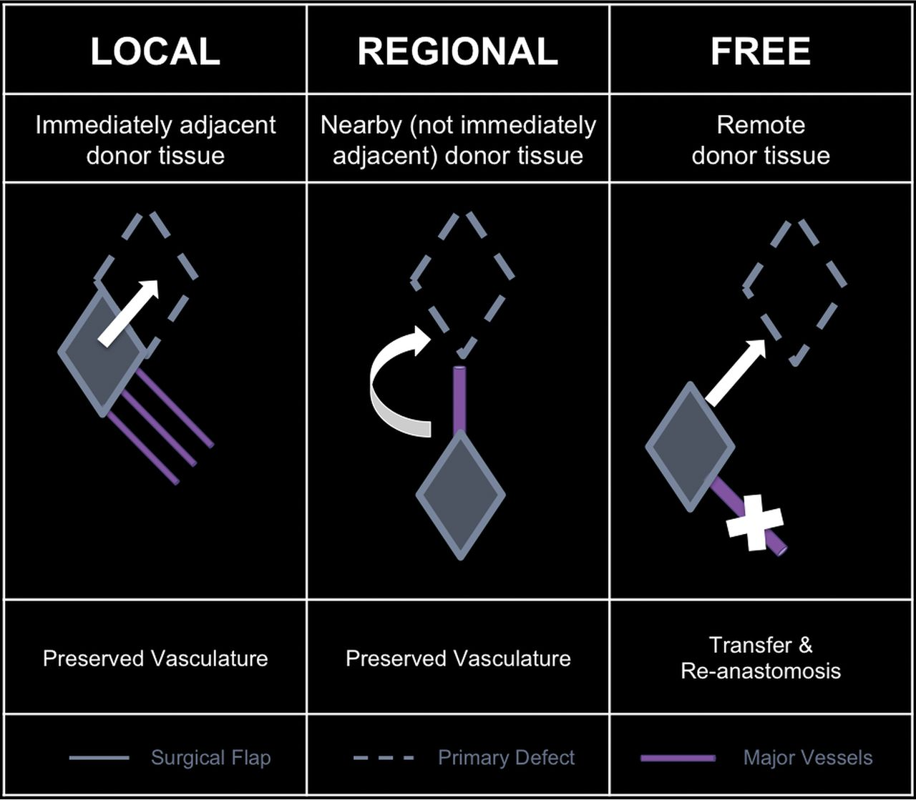
Introduction
Reconstructive free flap surgery is a complex method of wound closure for large wounds not amenable to linear (primary) closure
Notes:
The site and size of the defect determines which flap is used
The most commonly used flaps are the gracilis muscle for lower leg trauma
latissimus dorsi and rectus abdominis for breast reconstruction
Pectoralis major and radial forearm flap for head and neck reconstruction
The defect may be caused by trauma, infection or extensive surgery (e.g. mastectomy, head and neck cancer)

Slide 4
Introduction
The technique of free tissue transfer is complex and despite improvement in surgical skills, hypoperfusion, and necrosis of transferred tissues represent major problems

Slide 5
Introduction
The microvascular technique of free flap and its artery and vein transfer and its anastomosis to the receiver site has several stages
Primary ischemia
Reperfusion
Secondary ischemia
Cláudia Margarida Brito Pereira.Anesthesia and Surgical Microvascular Flaps. Revista Brasileira de Anestesiologia 563 Vol. 62, No 4, July-August, 2012

Slide 6
Primary ischemia
Harvesting the flap and clamping vessel, primary ischemia as soon as blood flow stops and intracellular anaerobic metabolism starts
Cláudia Margarida Brito Pereira.Anesthesia and Surgical Microvascular Flaps. Revista Brasileira de Anestesiologia 563 Vol. 62, No 4, July-August, 2012

Slide 7
Primary ischemia
In the presence of anaerobic metabolism
  Lactate accumulates
  Intracellular pH decreases
  ATP decreases
  Ca²⁺ increases
  Accumulation of proinflammatory mediators
The severity of the damage caused by primary ischemia is proportional to the duration of ischemia
Cláudia Margarida Brito Pereira.Anesthesia and Surgical Microvascular Flaps. Revista Brasileira de Anestesiologia 563 Vol. 62, No 4, July-August, 2012

Slide 8
Reperfusion
Reperfusion begins with vessel declamping
With minor injuries, the flap recovers and normal metabolism is restored
However, an injury (ischemia/ reperfusion) may occur if some flap factors are unfavorable, prolonged periods of ischemia or inadequate perfusion pressure
Cláudia Margarida Brito Pereira.Anesthesia and Surgical Microvascular Flaps. Revista Brasileira de Anestesiologia 563 Vol. 62, No 4, July-August, 2012

Slide 9
Secondary ischemia
This period is more harmful to the flap than primary ischemia
Massive intravascular thrombosis and significant interstitial edema
It can minimized with appropriate anesthetic approach
Cláudia Margarida Brito Pereira.Anesthesia and Surgical Microvascular Flaps. Revista Brasileira de Anestesiologia 563 Vol. 62, No 4, July-August, 2012

Slide 10
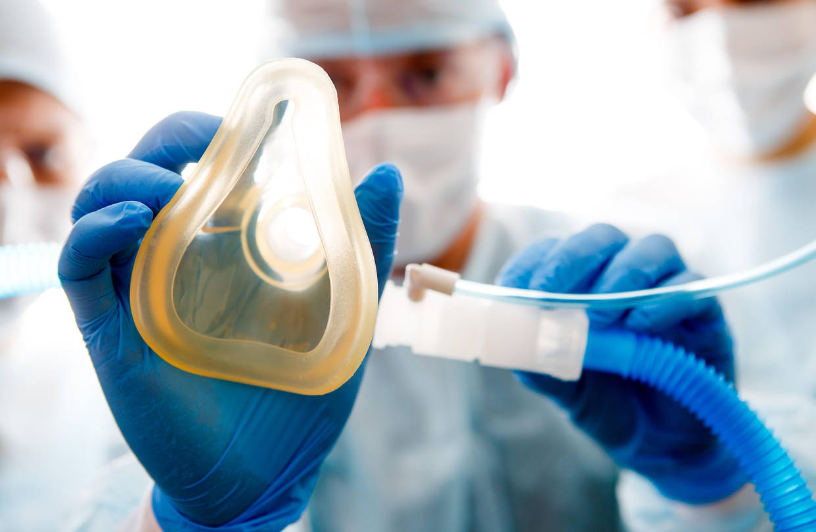
Introduction
Anesthesia can be an important factor in improving the success rate of surgery by controlling the hemodynamics and the regional blood flow
Natalia Hagau. ANnesthesia for free vascularized tissue transfer. Wiley InterScience .22 October 2008

Slide 11
Physiological considerations
Hagen-Poiseuille equation
If the flow in a vessel is laminar, it varies directly with the pressure difference between the two ends of the tube and the fourth power of the radius, and is inversely related to the length of the vessel and the coefficient of viscosity
John Adams. Anaesthesia for microvascular free tissue transfer. British Journal of Anaesthesia.Volume 3 Number 2 2003

Slide 12
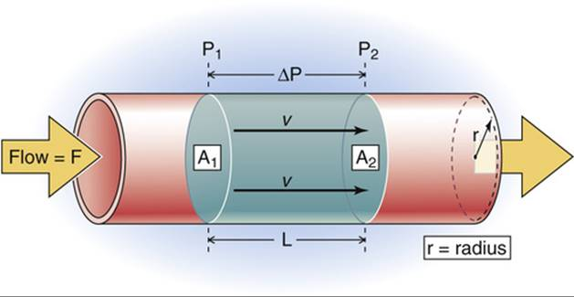
Physiological considerations
Hagen-Poiseuille equation
Blood flow = ΔP π r⁴
8 η l
ΔP = pressure difference between two ends of a tube
r = radius of the tube
η = viscosity
l = length of the tube
Notes:
If the flow in a vessel is laminar, it varies directly with the pressure difference between the two ends of the tube and the fourth power of the radius, and is inversely related to the length of the vessel and the coefficient of viscosity

Slide 13
Physiological considerations
The systemic arterial pressure is the main determinant of the pressure gradient across the transplanted tissue
As flow is related to the fourth power of the radius, a small decrease in vessel cross-sectional area will result in a large fall in flow

Slide 14
Physiological considerations
There is a non-linear relationship between blood viscosity and hematocrit
Viscosity rises steeply when the hematocrit exceeds 40%
Natalia Hagau. ANnesthesia for free vascularized tissue transfer. Wiley InterScience .22 October 2008

Slide 15
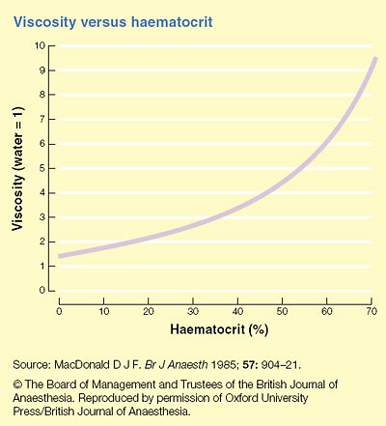

Slide 16
Physiological considerations
Hemodilution increases blood flow but also decreases the oxygen carrying capacity of the blood
A hematocrit of approximately 30% is thought to give the best balance between blood viscosity and oxygen content for oxygen transport to the tissues
Natalia Hagau. Anesthesia for free vascularized tissue transfer. Wiley InterScience .22 October 2008

Slide 17
Physiological considerations
During hypovolemia, maintaining the hematocrit of around 30%, through the transfusionof red blood cells, will maintain the blood viscosity
between 3.5 and 4 cP (physiological value 4.5 cP)

Slide 18

Physiological considerations
Increased mean arterial pressure and shear stress-dependent release of endothelium-derived relaxing factor are possible mechanisms that improved arteriolar and venular blood flow
Notes:
During extreme hemodilution, the cardiac output can no longer be sustained
Consequently, the blood flow will not develop the sufficient shear stress required for shear stress-dependent release of mediators, resulting in a reduced capillary perfusion

Slide 19
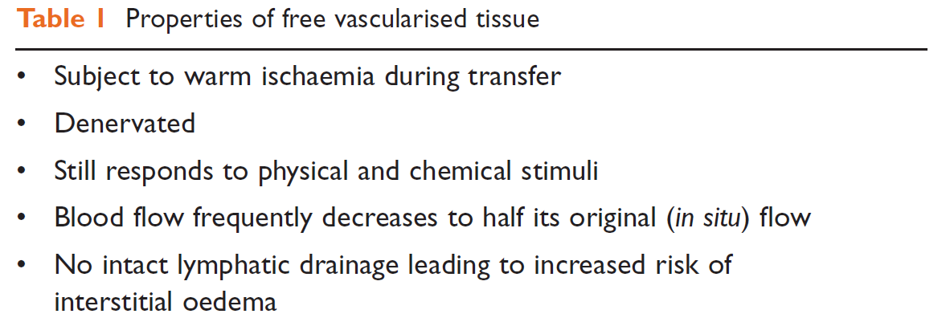
John Adams. Anaesthesia for microvascular free tissue transfer. British Journal of Anaesthesia.Volume 3 Number 2 2003

Slide 20
Pre-operative assessment

Slide 21
Pre-operative assessment
In microvascular surgery, the anesthetic plan depends on comorbidities and on the basic goal of maintaining an optimal blood flow for the vascularized free flap
Natalia Hagau. Anesthesia for free vascularized tissue transfer. Wiley InterScience .22 October 2008
Notes:
The goals of preoperative evaluation are to reduce patient risk and the morbidity of surgery

Slide 22
Pre-operative assessment
it is important to determine whether the patient will be able to tolerate the planned surgery procedure in accordance with the comorbidities
Natalia Hagau. Anesthesia for free vascularized tissue transfer. Wiley InterScience .22 October 2008

Slide 23
Pre-operative assessment
Chronological old age in itself is not a contraindication to free flap surgery
John Adams. Anaesthesia for microvascular free tissue transfer. British Journal of Anaesthesia.Volume 3 Number 2 2003
Notes:
and is not a risk factor for postoperative morbidity or flap failure

Slide 24


Pre-operative assessment
The age itself should not be considered a barrier to free flap transfer
Notes:
Patients who are elderly do not require ‘‘special’’ anesthesia

Slide 25
Pre-operative assessment
Elderly patients with head and neck cancer are often heavy smokers and drinkers and may have significant cardiac and respiratory co-morbidity as well as poor nutritional state
John Adams. Anaesthesia for microvascular free tissue transfer. British Journal of Anaesthesia.Volume 3 Number 2 2003

Slide 26

Pre-operative assessment
Patients should be advised to stop smoking preoperatively
Abstinence for 6–8 weeks is required to significantly improve the respiratory function
Natalia Hagau. Anesthesia for free vascularized tissue transfer. Wiley InterScience .22 October 2008

Slide 27

Preoperative smoking abstinence for longer than 3 weeks reduces the incidence of reconstructive head and neck surgery

Slide 28
Pre-operative assessment
A careful explanation to the patient about the anesthetic is required, including the use of PCA machines, invasive monitoring, urinary catheter and postoperative care
John Adams. Anaesthesia for microvascular free tissue transfer. British Journal of Anaesthesia.Volume 3 Number 2 2003

Slide 29

Pre-operative assessment
As high albumin levels are associated with better surgical outcome in head and neck cancer patients, preoperative intervention strategies that boost albumin levels could be considered for improving surgical outcome

Slide 30
Pre-operative assessment
Baseline investigations should include full blood count, urea and electrolytes, clotting screen and blood sugar
Chest X-ray, ECG, respiratory function tests, arterial blood gases and echocardiogram should be considered in patients with cardiac and respiratory risk factors
All patients should be cross-matched for all surgery requiring extensive dissection and reconstruction
John Adams. Anaesthesia for microvascular free tissue transfer. British Journal of Anaesthesia.Volume 3 Number 2 2003

Slide 31
Pre-operative assessment
The implementation of a multidisciplinary pre-operative evaluation driven by anesthetists, nutritionists, other medical specialists and health practitioners may reduce post-operative complications derived from pre-existing conditions
John Adams. Anaesthesia for microvascular free tissue transfer. British Journal of Anaesthesia.Volume 3 Number 2 2003

Slide 32
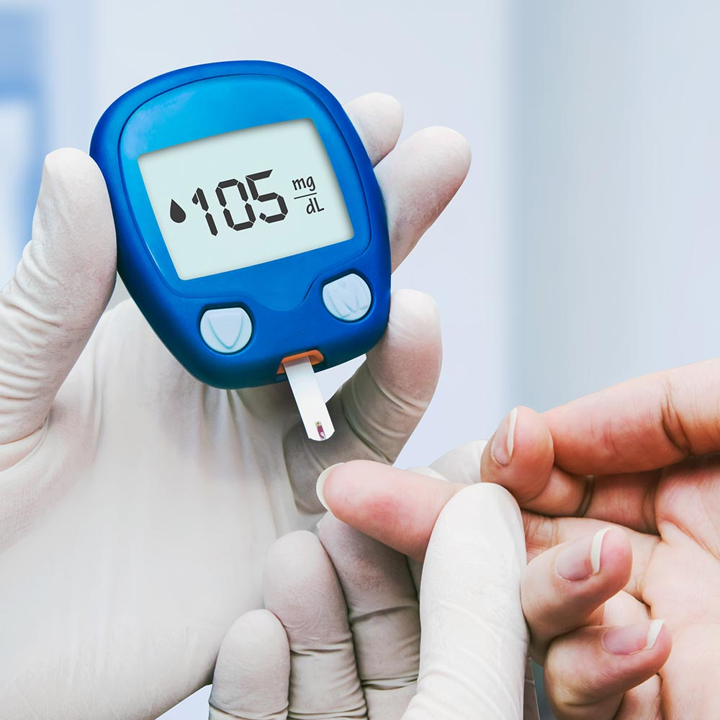
Pre-operative assessment
Diabetes mellitus
Acute and chronic hyperglycemia is associated with vascular leakage and tissue edema is more likely to be formed
Natalia Hagau. Anesthesia for free vascularized tissue transfer. Wiley InterScience .22 October 2008
Notes:
is the most common endocrine abnormality encountered in surgical patients and is associated with increased perioperative morbidity

Slide 33
Pre-operative assessment
Diabetes mellitus
Careful glucose monitoring is essential to minimize metabolic disturbances and to maintain an optimal free flap blood flow
Natalia Hagau. Anesthesia for free vascularized tissue transfer. Wiley InterScience .22 October 2008
Notes:
is the most common endocrine abnormality encountered in surgical patients and is associated with increased perioperative morbidity

Slide 34

Pre-operative assessment
A retrospective analysis over a period of 10 years involving TRAM flaps showed a significant increase in the incidence of flap failure, hernia, and necrosis in patients with BMI > 30

Slide 35

Incidence of free flap thrombosis was significantly higher
in ROTEM hypercoagulability compared to group without, 5/15 (33%) vs. 4/36 (11%), p = 0.047
ROTEM is a suitable method to detect hypercoagulability preoperatively with definite predictive capacity for postoperative free flap thrombosis in microvascular surgery
Notes:
Patients with preoperative hypercoagulation had significantly higher values of MCFEXTEM (p <0,001), MCFINTEM (p < 0,001), MCF FIBTEM (p < 0,001), and significantly lower - CFTEXTEM (p= 0,01), CFTINTEM (p= 0,02).

Slide 36
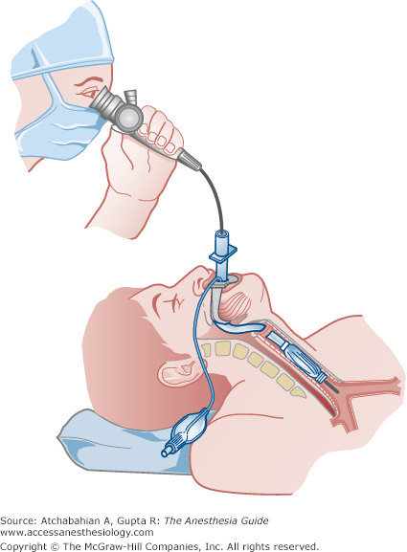
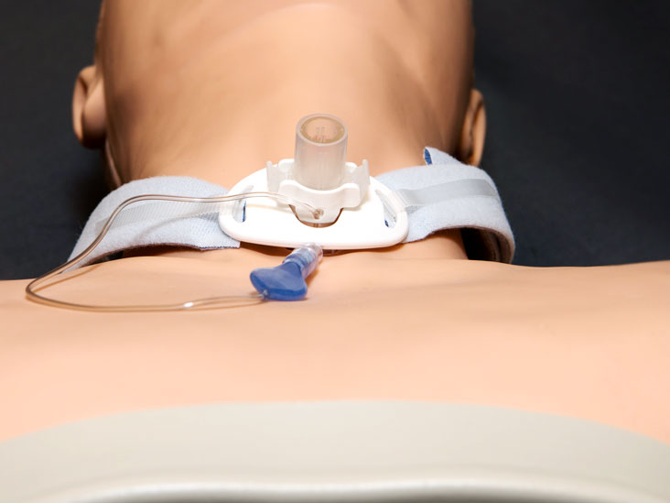
Pre-operative assessment
Careful planning for difficult airway management including tracheostomy if the airway is compromised
positioning and careful understanding of graft donor and recipient site considerations
Edward Noguera. Anesthesia for head and neck flap
reconstructive surgery. Anesthesia for Otolaryngologic Surgery. 2013
Notes:
Aside from the general anesthetic implications for coexisting comorbidities, perhaps the most important anesthetic implications of tissue transfers are:

Slide 37
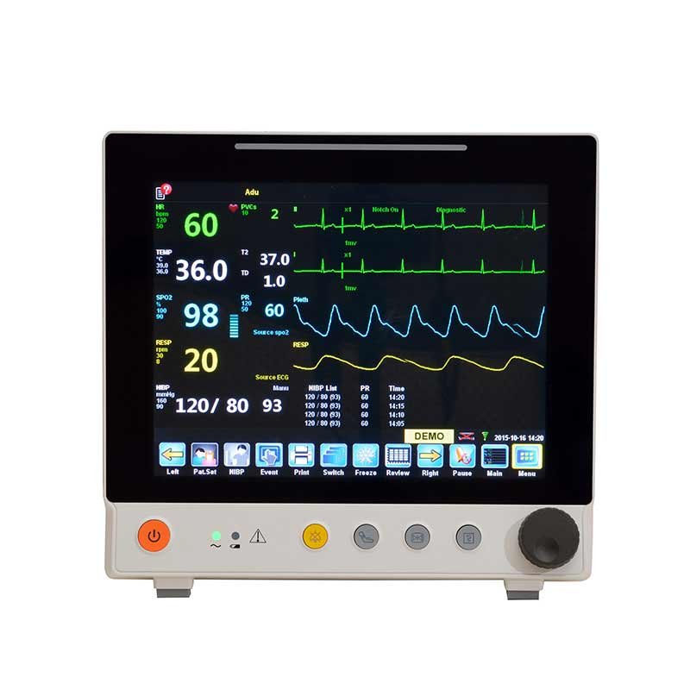
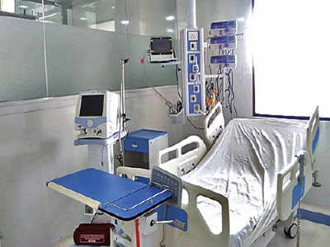
Pre-operative assessment
Choice of intraoperative monitoring
Considerations related to the length of surgery and thermoregulation
Flap perfusion considerations
Planning postoperative care and level of care
Edward Noguera. Anesthesia for head and neck flap
reconstructive surgery. Anesthesia for Otolaryngologic Surgery. 2013

Slide 38
Intraoperative Management

Slide 39
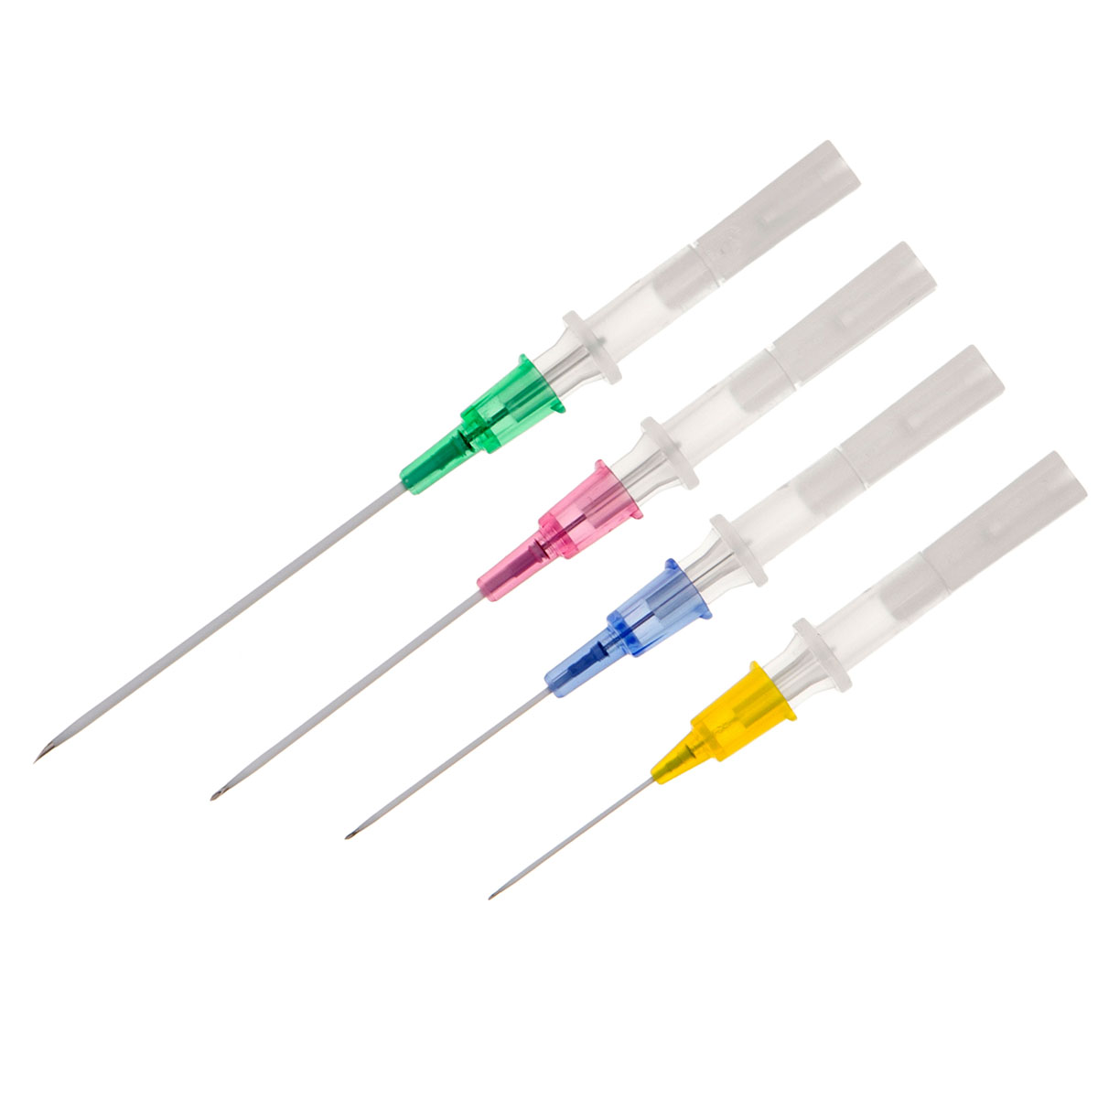
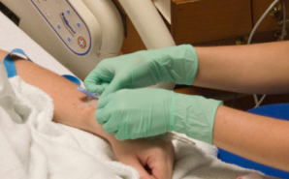
Access and monitoring
Catheterization is essential for good venous (large caliber) access
The location must be discussed with surgeon, as it can influence the harvesting place
Lauretta MP. Anaesthetic Challenging in Microsurgical Flap Reconstruction:
A Systematic Review. Journal of Anesthesia & Clinical Research.2017
Notes:
Because large mobilizations of fluids may occur during surgery,

Slide 40
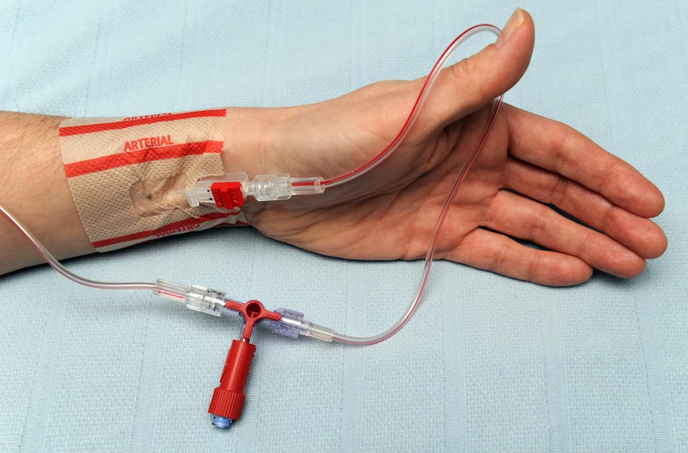
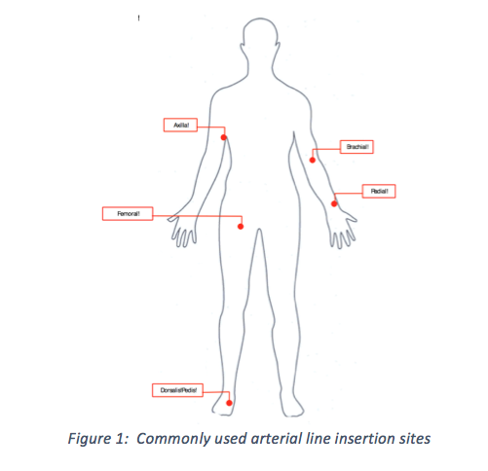
Access and monitoring
In addition to basic monitoring, invasive arterial pressure monitoring is recommended in these patients
Lauretta MP. Anaesthetic Challenging in Microsurgical Flap Reconstruction:
A Systematic Review. Journal of Anesthesia & Clinical Research.2017
Notes:
This allows not only precise and continuous monitoring of arterial pressure , as well as serial blood gases and hematocrit

Slide 41
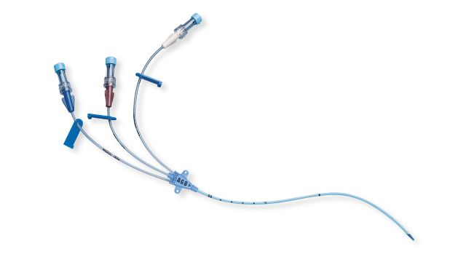
Access and monitoring
Central venous pressure monitoring
reflects the cardiac filling pressures and can be used for cardiac output management
It is useful if there is massive blood loss or the patient has poor peripheral access, but it is not recommended as routine
Lauretta MP. Anaesthetic Challenging in Microsurgical Flap Reconstruction:
A Systematic Review. Journal of Anesthesia & Clinical Research.2017
Notes:
Moreover, in head and neck surgery, direct access to central veins may be difficult or even impossible

Slide 42
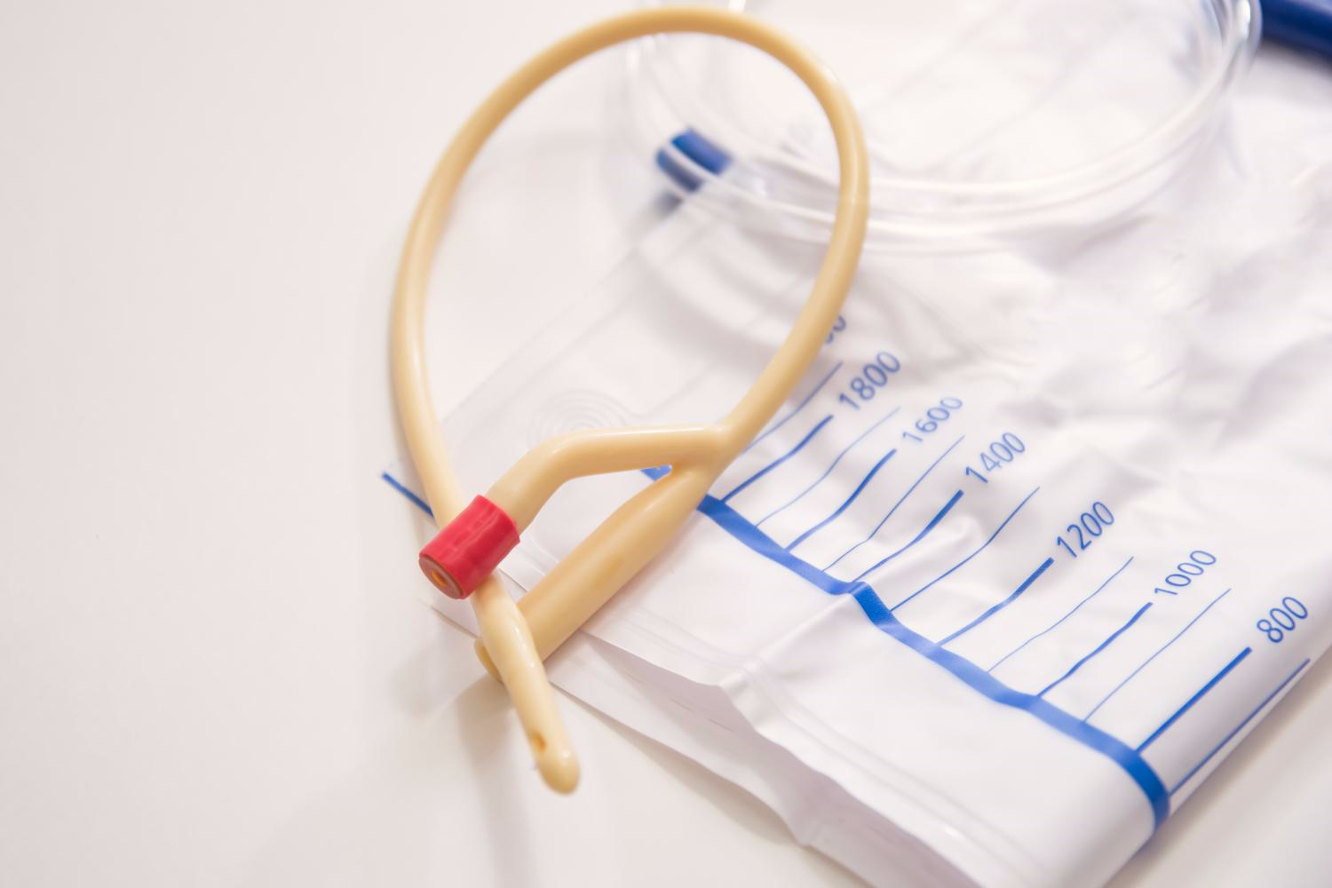
Access and monitoring
Urine output
Tube placement allows not only
monitoring but also the prevention
of bladder distension
An output from 1 to 2 mL/kg should
be kept
Lauretta MP. Anaesthetic Challenging in Microsurgical Flap Reconstruction:
A Systematic Review. Journal of Anesthesia & Clinical Research.2017

Slide 43
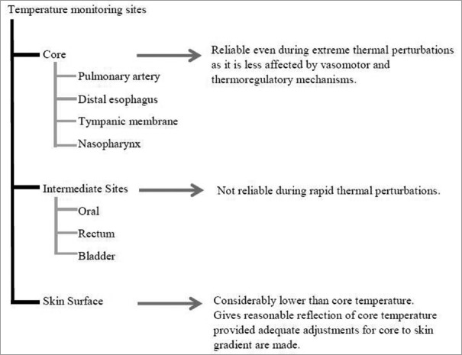
Intraoperative monitoring
Temperature monitoring
Lauretta MP. Anaesthetic Challenging in Microsurgical Flap Reconstruction:
A Systematic Review. Journal of Anesthesia & Clinical Research.2017

Slide 44
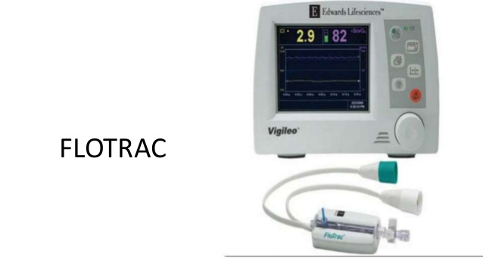
Intraoperative monitoring
FloTrac Vigileo system, based on arterial waveform analysis, and patient's age, sex, height, weight is often used in FF reconstructive surgery as mini invasive and reliable
Lauretta MP. Anaesthetic Challenging in Microsurgical Flap Reconstruction:
A Systematic Review. Journal of Anesthesia & Clinical Research.2017
Notes:
Hemodynamic monitoring should be used in high risk patients undergoing major surgery to enhance fluid optimization, reduce mortality, morbidity and reduce costs

Slide 45
Hypotension Probability Indicator (HPI)
Notes:
Hypotension Probability Indicator” (HPI) could be promising: the advantage to predict a drop in the mean arterial pressure, before hypotension occurs, can be more effective than a fluid therapy titrated to maintain SVV less than 13%

Slide 46
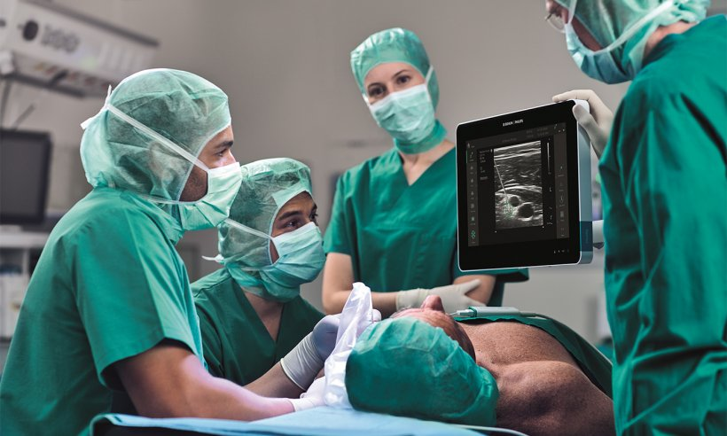
Type of anesthesia
The regional anesthesia
In microvascular surgery (which implies long lasting procedures, requiring many hours of anesthesia), regional blocks are mostly associated with general anesthesia
Natalia Hagau. Anesthesia for free vascularized tissue transfer. Wiley InterScience .22 October 2008

Slide 47
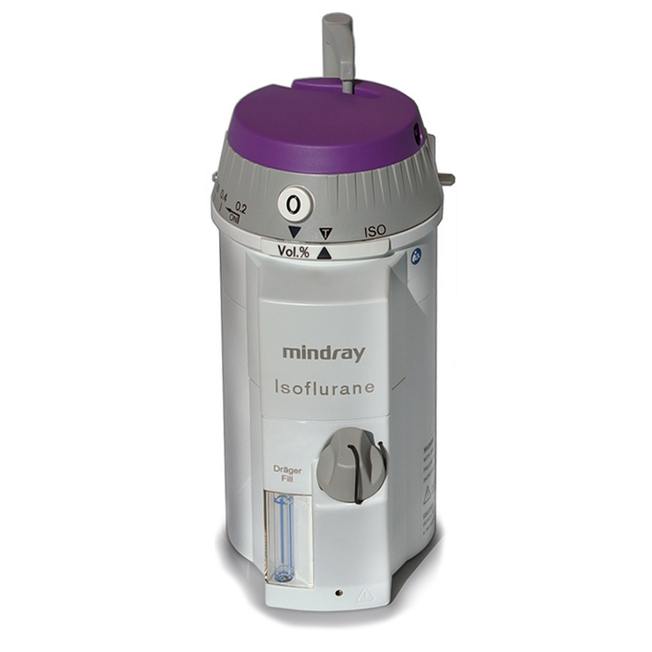
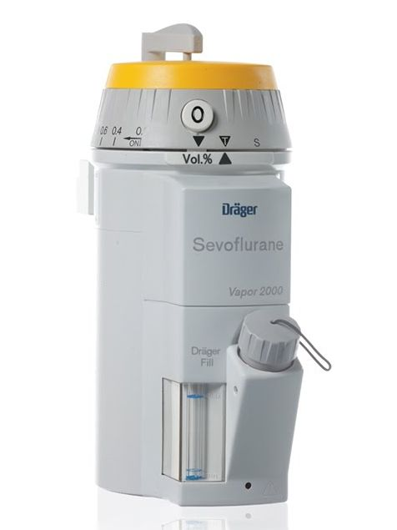
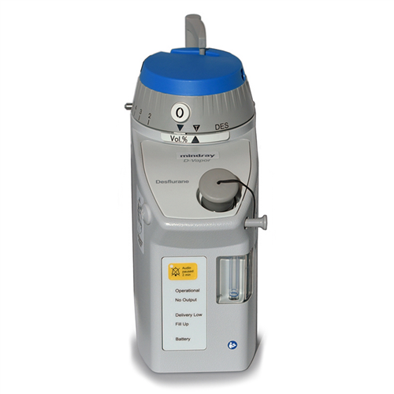
Type of anesthesia
Effects of different volatile anesthetics on blood flow in the free flaps are not yet well known
Natalia Hagau. Anesthesia for free vascularized tissue transfer. Wiley InterScience .22 October 2008

Slide 48
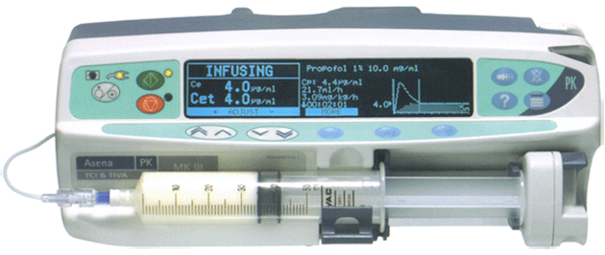
Type of anesthesia
Patients in the TIVA group required less perioperative fluids (both crystalloid and colloid) to maintain hemodynamic stability, furthermore, after multivariate regression, patients in the TIVA group had a significantly reduced risk of pulmonary complication compared with the inhalation group
Lauretta MP. Anaesthetic Challenging in Microsurgical Flap Reconstruction:
A Systematic Review. Journal of Anesthesia & Clinical Research.2017

Slide 49
Type of anesthesia
Some anesthetist may be concerned about the possibility of metabolic acidosis-propofol infusion syndrome (PRIS)which would cause damage to a fresh anastomosis in flaps
Lauretta MP. Anaesthetic Challenging in Microsurgical Flap Reconstruction:
A Systematic Review. Journal of Anesthesia & Clinical Research.2017
Notes:
The association between PRIS and propofol infusion is demonstrated only for doses higher than 4 mg/kg/h when the duration lasts longer than 48 h

Slide 50
Fluid management
Hyperdynamic circulation
An adequate arterial pressure with vasodilatation provides good tissue perfusion by
  providing high regional blood flow
  improving the patency of the microvasculature
  maintaining the fluidity of the blood in the microcirculation
Although theoretically attractive due to the consequent reduction in viscosity, there is no clinical evidence that it is beneficial
N Nimalan BSc MBBS FRCA .Anaesthesia for free flap breast reconstruction. the British Journal of Anaesthesia.2015
Notes:
The free flaps are subject to interstitial edema, as they do not have lymphatic drainage and, thus, excessive fluid administration can be deleterious

Slide 51
Fluid management
Any reduction in cardiac output induces vasoconstriction mediated by the sympathetic nervous system, renin–angiotensin aldosterone, and baroreceptor reflex
Therefore, maintenance of an appropriate cardiac output is important for free flap surgery
N Nimalan BSc MBBS FRCA .Anaesthesia for free flap breast reconstruction. the British Journal of Anaesthesia.2015

Slide 52
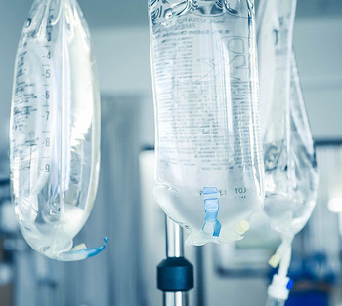
Fluid management
Different studies, demonstrated the predictive relationship between the quantity of intraoperative fluid administrated and the rate of postoperative complications in FF surgery
Lauretta MP. Anaesthetic Challenging in Microsurgical Flap Reconstruction:
A Systematic Review. Journal of Anesthesia & Clinical Research.2017

Slide 53
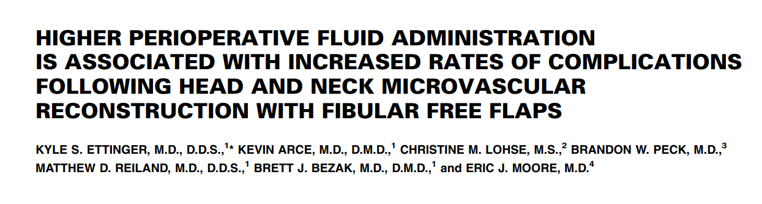
Fluid management
From the analysis on 154 patients with head and neck reconstructions with fibular FFs
Fluid volume higher than 5500 ml was associated with an increase in medical and surgical complications
A cut-off value of 7000 ml was identified as the only significant risk factor for major complications

Slide 54
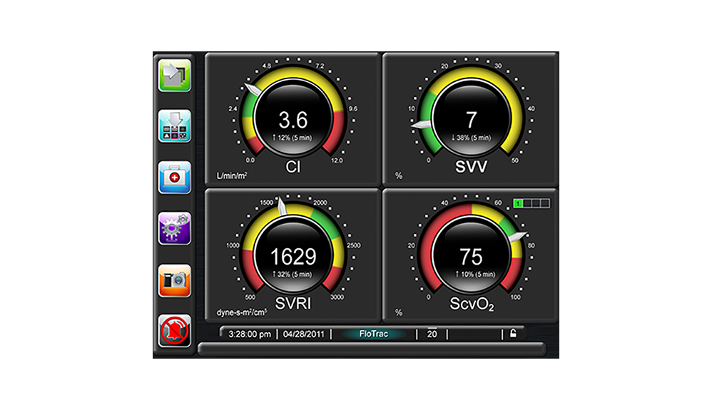
Fluid management
Every patient can be identified as fluid responsive by measuring
  cardiac output (CO)
  cardiac index (CI)
  stroke volume variation (SVV)
  pulse pressure variation (PPV)
Lauretta MP. Anaesthetic Challenging in Microsurgical Flap Reconstruction:
A Systematic Review. Journal of Anesthesia & Clinical Research.2017
Notes:
According recent literature, a goal directed fluid therapy, titrated to keep SVV ≤ 13%, with the use of mini invasive arterial pulse contour device, results in improved oxygen delivery and reduces the intravenous fluid administration, with better outcomes

Slide 55
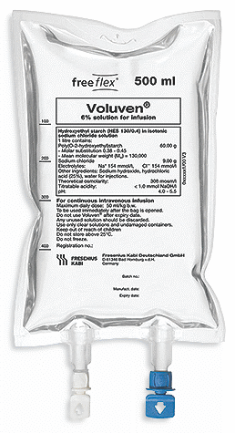
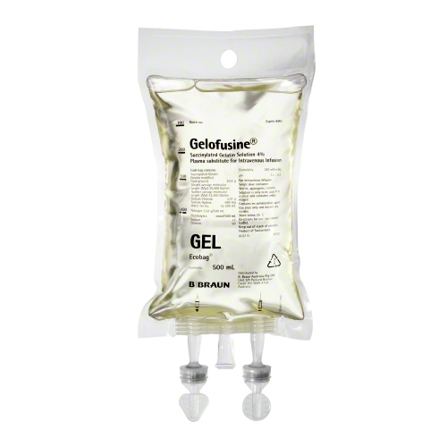
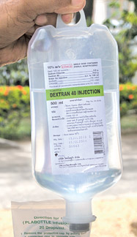
Fluid management
Synthetic colloids
Lauretta MP. Anaesthetic Challenging in Microsurgical Flap Reconstruction:
A Systematic Review. Journal of Anesthesia & Clinical Research.2017
Notes:
Synthetic colloidsGelatins
Dextrans
Hydroxyethyl starches
have the advantage of being readily available, stable, relatively inexpensive, and with no risk of transmitting infectious diseases

Slide 56
Fluid management
Dextrans as plasma substitutes were more effective than gelatins or large volumes of crystalloids
Its antithrombotic effects by reducing platelet adhesion and depression of factor VIII activity represent an advantage in terms of thromboprophylaxis, but limit the amount administered during a major loss of blood
In addition, its benefit in terms of flap survival has not been clinically demonstrated yet
Lauretta MP. Anaesthetic Challenging in Microsurgical Flap Reconstruction:
A Systematic Review. Journal of Anesthesia & Clinical Research.2017

Slide 57
Fluid management
Hydroxyethyl starches have characteristics that may be beneficial for microvascular surgery
They are good plasma expanders, have low incidence of anaphylactic reactions, and may reduce reperfusion injury and hyperpermeability after temporary ischemia
Its disadvantages include prolongation of bleeding time (if used in large quantities)
Lauretta MP. Anaesthetic Challenging in Microsurgical Flap Reconstruction:
A Systematic Review. Journal of Anesthesia & Clinical Research.2017

Slide 58
Fluid management
Hydroxyethyl starch seems more promising to expand plasma volume and reduce blood viscosity if compared to gelatin-based colloids
Regarding the use of colloids, data have shown that volume higher than 20-30 ml/kg/24 h can increase perioperative morbidity
Lauretta MP. Anaesthetic Challenging in Microsurgical Flap Reconstruction:
A Systematic Review. Journal of Anesthesia & Clinical Research.2017

Slide 59

Haemoglobin
In UK, as a resulted from a national survey,
practice for blood loss in theatre is varied, with a mean trigger for
blood transfusion of Haemoglobin 7.8 g/dl [21].
Even if flap perfusion and peripheral oxygen delivery is a priority, several observational studies in head and neck cancer have highlighted how allogenic blood transfusion is associated with higher rate of postoperative
complications and worse prognosis, and anaesthesiologist usually
follow blood conservation strategies in high-risk patients [23].

Slide 60
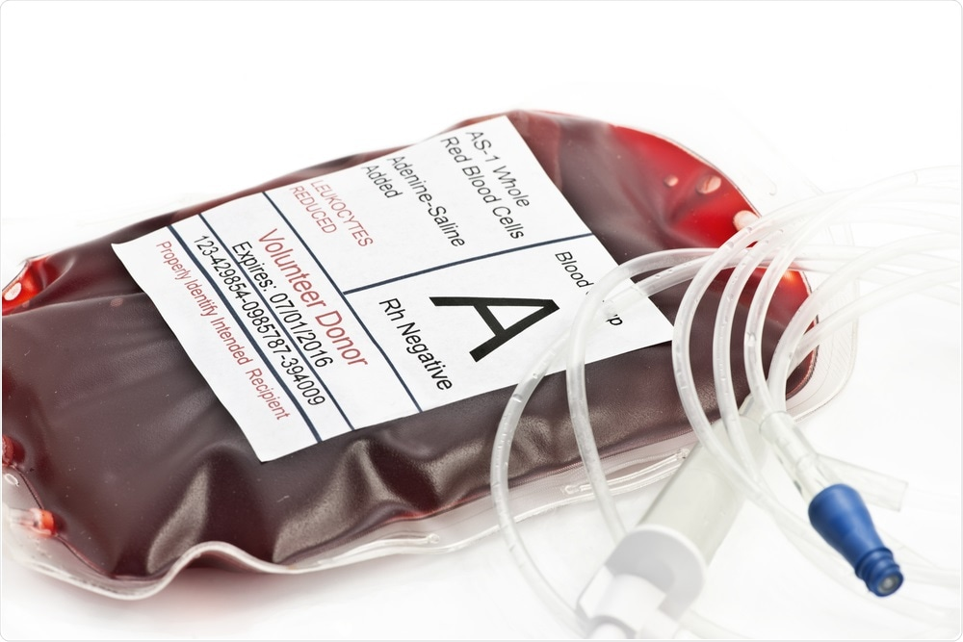
Hemoglobin
Hct of about 30% appears to be one that offers the best balance between viscosity and O²-carrying capacity
Cláudia Margarida Brito Pereira.Anesthesia and Surgical Microvascular Flaps. Revista Brasileira de Anestesiologia 563 Vol. 62, No 4, July-August, 2012
Notes:
Further reductions in hematocrit did not result in greater benefit, and benefit may even be overcome by the decrease in O²-carrying capacity

Slide 61
Hemoglobin
A “liberal” transfusion policy is associated with increased morbidity and mortality
Blood transfusion is recommended if hemoglobin falls to values below 7-8 g/dL
If bleeding is significant, administration of platelets and coagulation factors may be necessary
Cláudia Margarida Brito Pereira.Anesthesia and Surgical Microvascular Flaps. Revista Brasileira de Anestesiologia 563 Vol. 62, No 4, July-August, 2012

Slide 62
Blood Pressure management
During the dissection stages of surgery, controlled hypotension may be requested
Vasodilators are generally avoided as they may be harmful due to the risk of blood flow steal away from the flap
Cláudia Margarida Brito Pereira.Anesthesia and Surgical Microvascular Flaps. Revista Brasileira de Anestesiologia 563 Vol. 62, No 4, July-August, 2012

Slide 63
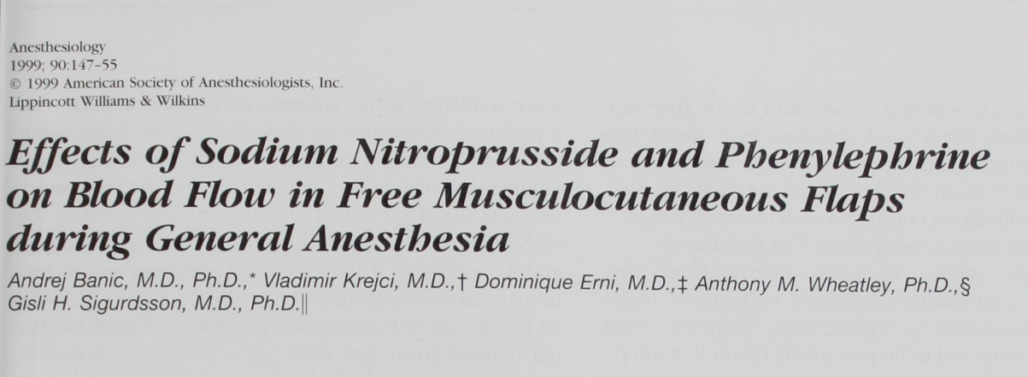
Blood Pressure management
Animal studies of sodium nitroprusside showed marked reduction of MAP and BF in flap and may cause reflex vasoconstriction when infusion is interrupted
Notes:
Vasodilators are generally avoided as they may be harmful due to the risk of blood flow steal away from the flap

Slide 64
Blood Pressure management
During anastomosis of the flap, normotension is usually sufficient to ensure an adequate perfusion pressure through the tissue
The use of vasoconstrictors is a contentious issue in free flap anesthesia, largely over fears that systemic vasoconstriction leads to reduced flap perfusion
Cláudia Margarida Brito Pereira.Anesthesia and Surgical Microvascular Flaps. Revista Brasileira de Anestesiologia 563 Vol. 62, No 4, July-August, 2012

Slide 65
Blood Pressure management
Evidence from animal models has revealed that the use of vasopressors leads to vasoconstriction in the microcirculation of the flap; however, this has not been shown in the clinical settings
There are very few good quality studies that support this and only a few vasoconstrictors have been studied
Lauretta MP. Anaesthetic Challenging in Microsurgical Flap Reconstruction:
A Systematic Review. Journal of Anesthesia & Clinical Research.2017

Slide 66
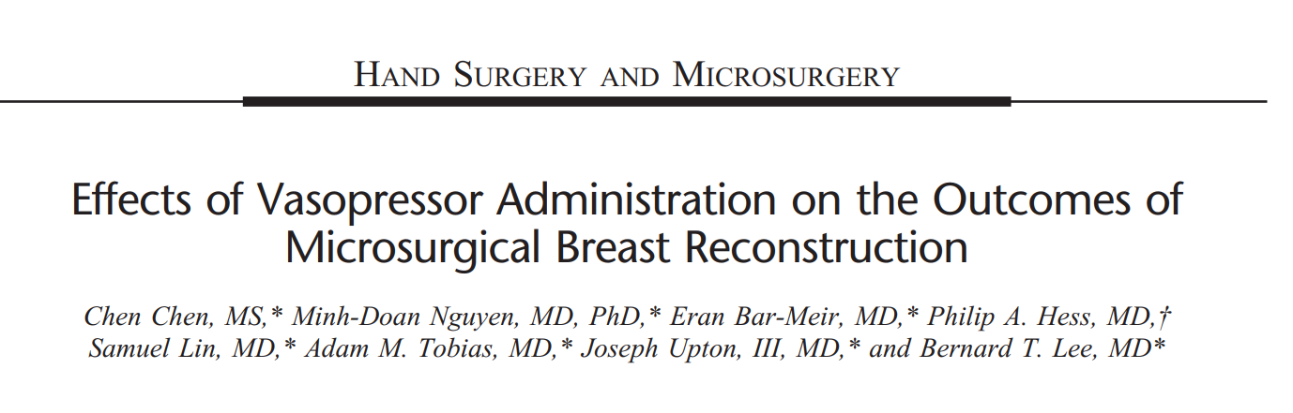
Blood Pressure management
A recent retrospective study of over 250 microsurgical breast reconstructions examined intraoperative phenylephrine±ephedrine use and concluded that vasopressor use did not adversely affect outcome

Slide 67
Blood Pressure management
Dobutamine and vasoconstrictors can be safely used if the goals for BP and CI are not achieved with SVV<10-13%
Lauretta MP. Anaesthetic Challenging in Microsurgical Flap Reconstruction:
A Systematic Review. Journal of Anesthesia & Clinical Research.2017

Slide 68
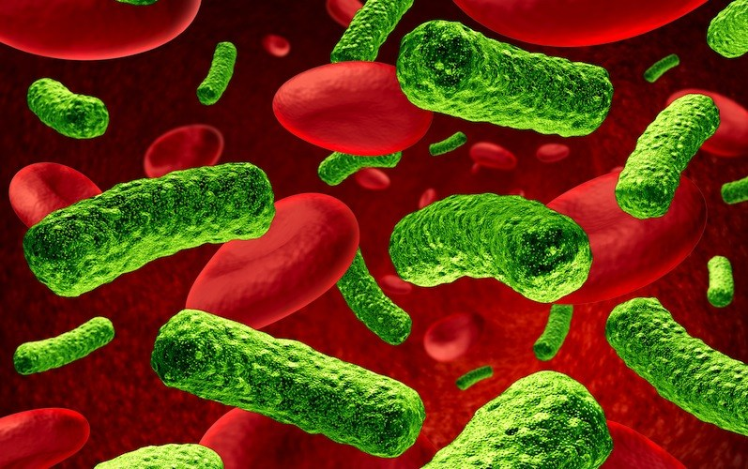
Antibiotics
From a number of international studies,
the choice of antibiotic appears to affect the incidence of postoperative infections and flap site infections more than the duration
Lauretta MP. Anaesthetic Challenging in Microsurgical Flap Reconstruction:
A Systematic Review. Journal of Anesthesia & Clinical Research.2017

Slide 69
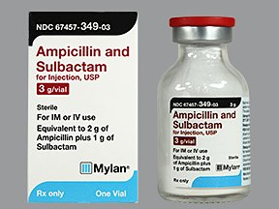
Antibiotics
From a number of evidence ampicillin-sulbactam or cefuroxime are the preferred prophylactic antibiotic
Clindamycin prophylaxis increases the risk of recipient surgical site infection, moreover, for patients with penicillin allergy, broader gram-negative coverage is recommended
Lauretta MP. Anaesthetic Challenging in Microsurgical Flap Reconstruction:
A Systematic Review. Journal of Anesthesia & Clinical Research.2017
Notes:
for major clean-contaminated head and neck procedures, less than or equal to 24 h of antibiotic prophylaxis is likely sufficient

Slide 70
Temperature control
Temperature control is extremely important, both during and after microvascular surgery
Hypothermia is a major cause of peripheral vasoconstriction and increased viscosity
Lauretta MP. Anaesthetic Challenging in Microsurgical Flap Reconstruction:
A Systematic Review. Journal of Anesthesia & Clinical Research.2017

Slide 71
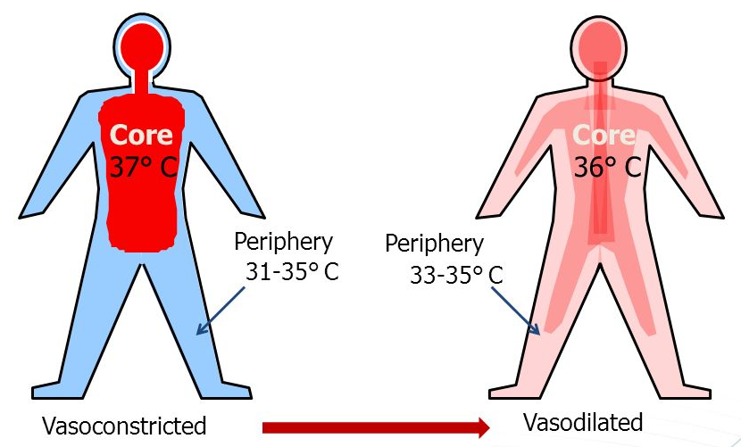
Temperature control
Maintenance of the temperature may be difficult, because of the large surgical areas exposed for a long period of time and to the extensive fluid and blood losses
Furthermore, anesthesia changes the thermoregulatory mechanisms
Lauretta MP. Anaesthetic Challenging in Microsurgical Flap Reconstruction:
A Systematic Review. Journal of Anesthesia & Clinical Research.2017

Slide 72
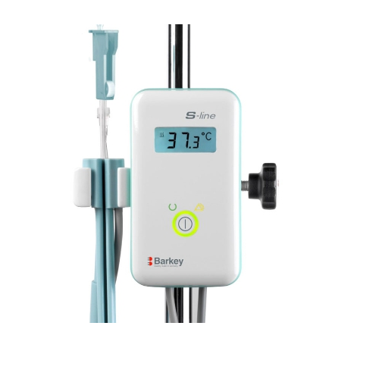
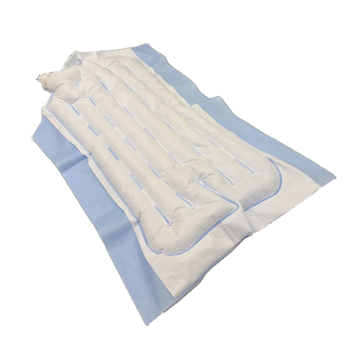
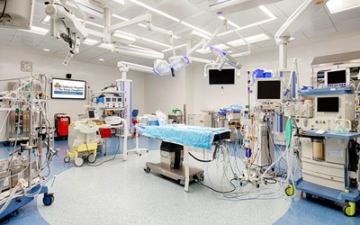
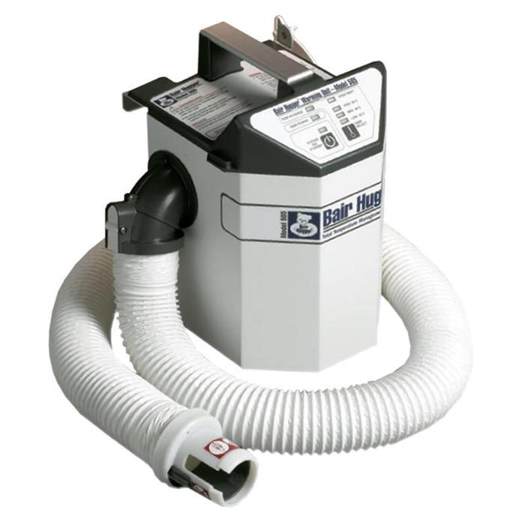
Temperature control
Warm air blankets, warm intravenous fluids, humidified and warmed anesthetic gases and, in some places, with a high temperature in the operating room (24–25 °C)
Lauretta MP. Anaesthetic Challenging in Microsurgical Flap Reconstruction:
A Systematic Review. Journal of Anesthesia & Clinical Research.2017

Slide 73
Temperature control
The central and peripheral temperatures have to be monitored
The difference between the two temperatures should not be higher than 2 ° C
The ideal difference (Δt) between them should be less than 1°C
A high gradient reflects a low volemic status of the patient or the decrease in the cardiac output
Lauretta MP. Anaesthetic Challenging in Microsurgical Flap Reconstruction:
A Systematic Review. Journal of Anesthesia & Clinical Research.2017

Slide 74
Positioning
Preoperative preparation and patient positioning can be time consuming and it is important to prevent hypothermia during this phase of exposure
Cláudia Margarida Brito Pereira.Anesthesia and Surgical Microvascular Flaps. Revista Brasileira de Anestesiologia 563 Vol. 62, No 4, July-August, 2012

Slide 75
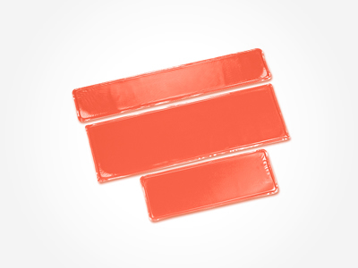
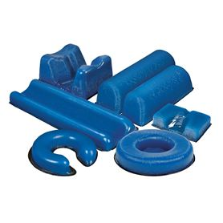
Positioning
Gel pads are particularly useful for areas of greatest risk
The positioning may be readjusted several times during surgery, requiring a reassessment of pressure zones
Cláudia Margarida Brito Pereira.Anesthesia and Surgical Microvascular Flaps. Revista Brasileira de Anestesiologia 563 Vol. 62, No 4, July-August, 2012

Slide 76
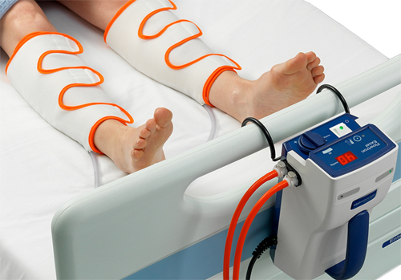
VTE prophylaxis
The use of pneumatic compression stockings is recommended
Passive mobilization of the limbs several times during surgery
Cláudia Margarida Brito Pereira.Anesthesia and Surgical Microvascular Flaps. Revista Brasileira de Anestesiologia 563 Vol. 62, No 4, July-August, 2012
Notes:
Prophylaxis of thromboembolic events should be given to all patients (low molecular weight heparin, preoperatively)

Slide 77
Vasospasm
Spasm of transplanted vessels can occur after surgical manipulation or intimal injury, which may occur during or after surgery
The surgeon can use topical vasodilators (papaverine, verapamil, lidocaine) to reduce this phenomenon
Cláudia Margarida Brito Pereira.Anesthesia and Surgical Microvascular Flaps. Revista Brasileira de Anestesiologia 563 Vol. 62, No 4, July-August, 2012

Slide 78
Common intraoperative complications
Hypotension
Hypothermia
Breathing circuit failure
Dislodgement of vascular catheters
Edward Noguera. Anesthesia for head and neck flap reconstructive surgery. Anesthesia for Otolaryngologic Surgery.2013

Slide 79
Postoperative Anesthetic Management

Slide 80
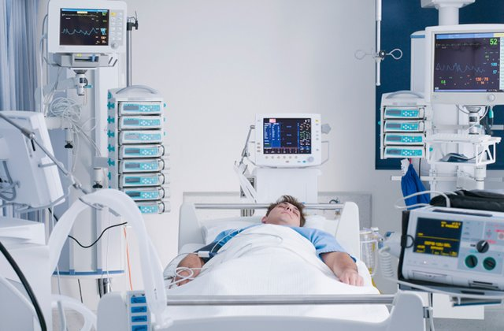
ICU admission
number of recent studies support that uncomplicated FFs patients may be safely assisted outside ICU
No significant changes in
flap survival, inpatient
morbidity or mortality
Lauretta MP. Anaesthetic Challenging in Microsurgical Flap Reconstruction:
A Systematic Review. Journal of Anesthesia & Clinical Research.2017

Slide 81
ICU admission
Ideally, uncomplicated patients receiving microvascular surgery should be step down in high-dependency units or equipped specialized surgical units
However, the pivotal role of nursing and health practitioner staff cannot be underestimated, such as their workload
Lauretta MP. Anaesthetic Challenging in Microsurgical Flap Reconstruction:
A Systematic Review. Journal of Anesthesia & Clinical Research.2017

Slide 82
Early postoperative extubation and tracheostomy
Surgical tracheotomy has rare severe complications but presents the danger to prolong the hospital stay
According the last indications of ERAS protocols, the decision to perform a tracheotomy is now linked to the presence of specific conditions such as advanced cancer stage and location, otherwise, early extubation is always preferred
Lauretta MP. Anaesthetic Challenging in Microsurgical Flap Reconstruction:
A Systematic Review. Journal of Anesthesia & Clinical Research.2017

Slide 83
Pain management
Multimodal analgesia
Notes:
Opioid-sparing and multimodal analgesia, prescribing nonsteroidal anti-inflammatory drugs (NSAIDs), cyclooxygenase inhibitors (COX inhibitors), and paracetamol, is safe, effective, able to reduce narcotic side effects and to facilitate rapid recovery after surgery
when this approach is not sufficient, patient controlled analgesia (PCA) can be eligible
For plastic reconstructive surgery with DIEP-flaps, additional nerve blocks can be considered, such as the TAP block

Slide 84
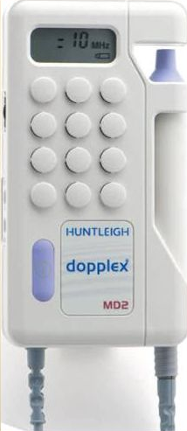
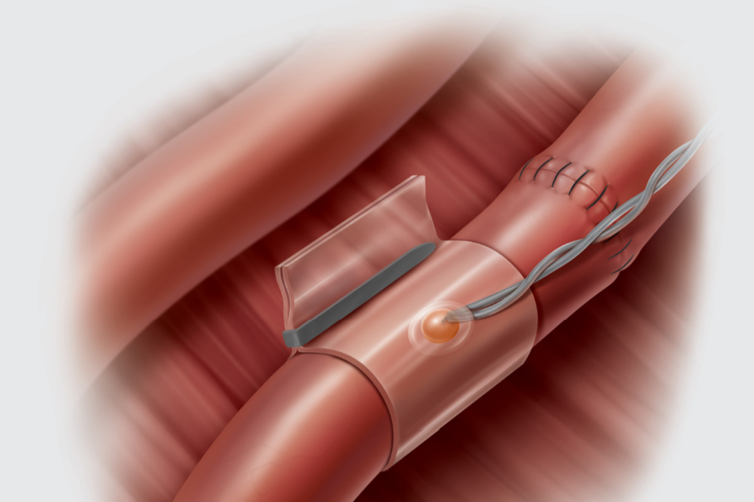
Flap perfusion monitoring
Flap clinical monitoring (color, capillary return, temperature) has limited value
instruments :
Doppler, implantable Doppler, fluorescence angiography, near infrared spectroscopy (NIRS), contrast enhanced duplex
Lauretta MP. Anaesthetic Challenging in Microsurgical Flap Reconstruction:
A Systematic Review. Journal of Anesthesia & Clinical Research.2017

Slide 85
Postoperative care
Normothermia (Δt < 1°C)
Normal systolic blood pressure (> 100 mm Hg)
Hematocrit 30% (monitoring in the first 24 h qid)
Urine output >1mL/kg/h
SpO2 > 94% Effective analgesia
Periodic monitoring of flap and continuous monitoring of flap blood flow (Doppler)
Cláudia Margarida Brito Pereira.Anesthesia and Surgical Microvascular Flaps. Revista Brasileira de Anestesiologia 563 Vol. 62, No 4, July-August, 2012

Slide 86
Conclusions
Anesthetic management in microvascular surgery clearly affects the outcome and flap viability
The role of the anesthesiologist includes the optimization of the physiological conditions for flap survival without increasing non-surgical morbidity
Close communication and knowledge of the steps as well as of the pathophysiology are necessary to ensure a favorable outcome

Slide 87
Thank you

